Slide 1
INTRODUCTION OF DIGITAL IMAGE PROCESSING
Image processing is a method to perform some operations on an image, in order to get an enhanced image or to extract some useful information from it. It is a type of signal processing in which input is an image and output may be image or characteristics associated with that image.
The digital image processing deals with developing a digital system that performs operations on an digital image.

Slide 2
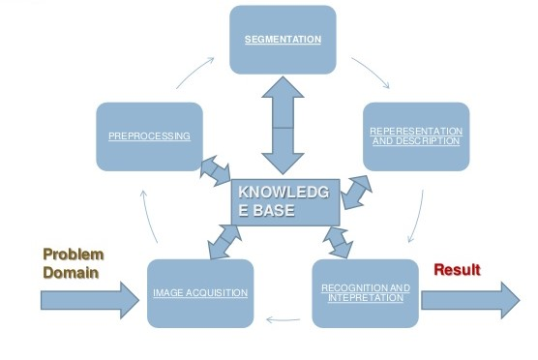
STEPS IN DIGITAL IMAGE PROCESSING

Slide 3
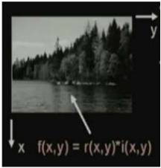
IMAGE
Image is replica of object.
An image defined in the “real world” is considered as a two dimentional function f(x,y), where x and y are spatial coordinates and the amplitude of f at any pair of coordinates (x,y) is called intensity or gray level of the image at that point.
TYPES OF IMAGES:
Gray tone image
Binary image

Slide 4
INTRODUCTION TO IMAGE SEGMENTATION
The purpose of image segmentation is to partition an image into its meaningful regions with respect to a particular application.
Segmentation divides an image into its constituent regions or objects.
Segmentation allows to extract in image.

Slide 5
SEGMENTATION ALGORITHM
Image segmentation algorithm based on one of two basic property of intensity values: discontinuity and similarity.
First category is to partition of an image based on abrupt change in intensity, such as an edge in an image.
Second category is based on partitioning an image into regions that are similar according to predefined criteria. Thresholding approach falls under this category.

Slide 6
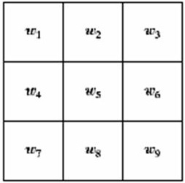
DETECTION OF DISCONTINUITIES
Detect the three basic types of discontinuities
Points, lines and edges.
The common way is to run a mask through the image.

Slide 7
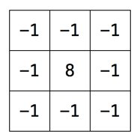
POINT DETECTION
A point has been detected at the location on which the mask is centered if
|R|>=T
where,
T is a nonnegative threshold
R is the sum of product of coefficient
with the gray levels contained in the
region encompassed by the mask

Slide 8
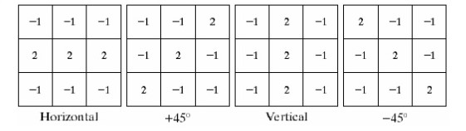
LINE DETECTION
Horizontal mask will result with maximum response when a line pass through the middle row of the mask with a constant background.
The similar idea is used with other masks.

Slide 9
EDGE DETECTION
An edge is a set of connected pixels that lies on the boundary between two regions
Process to identify edges in an image to be used as a fundamental asset in image analysis.
Locating areas with strong intensity contrasts.

Slide 10
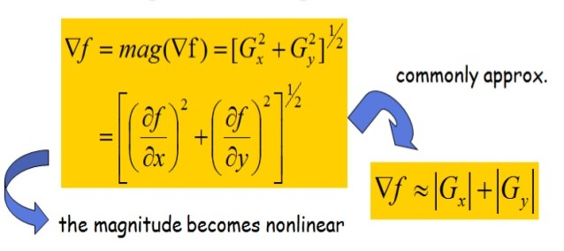
APPROACHES FOR IMPLEMENTING
First order derivative(Gradient operator)
Second order derivative(Laplacian operator)
First derivatives are implemented using the magnitude of the gradient

Slide 11
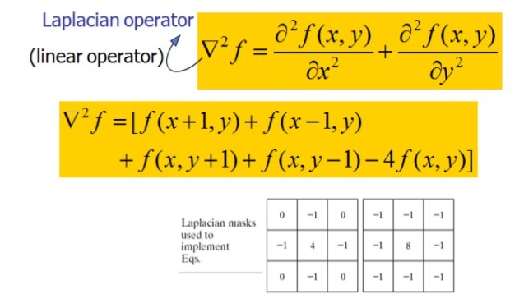
LAPLACIAN

Slide 12
THRESHOLD SELECTION
Thresholding is the simplest, powerful and most frequently used technique for image segmentation.
It is useful in discriminating foreground from the background.
Thresholding operation is use to convert a gray scale image into binary image

